Slide 1
Voter Registration
August 30, 2018

Slide 2
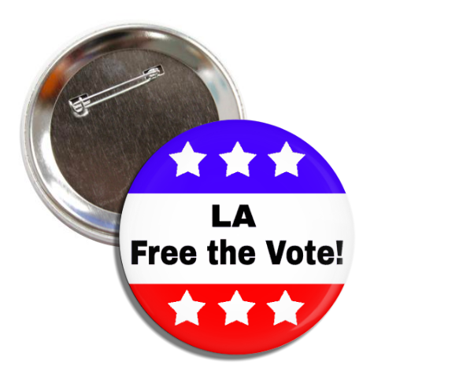
Board of Supervisors Motions
February 2018 motion to develop Countywide plan for voter education and registration of eligible justice-involved people
June 2018 response recommended a variety of efforts to increase voter registration for justice-involved people
July 2018 motion to create taskforce whose primary focus is to offer voter registration and education to justice-involved populations
Especially those on probation/post-release community supervision
September 2018 Taskforce launches LA Free the Vote campaign

Slide 3
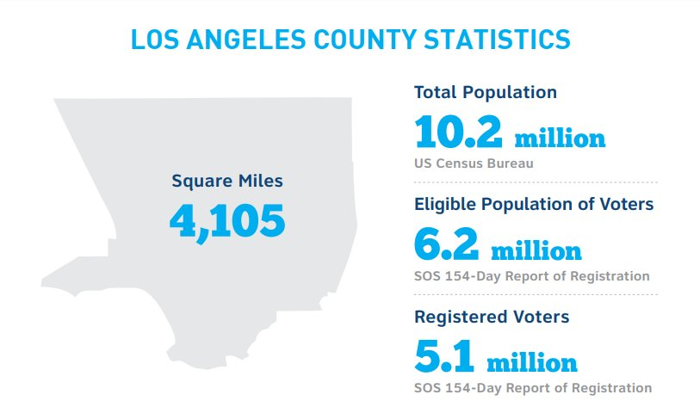

Slide 4
Goals
Enhance voting opportunities for every eligible American.
Remove discrimination in the voting process.
Increase voter registration in disenfranchised communities.

Slide 5
Who Can Vote?
In accordance with California state law:
Most people in county jails can vote*
People on probation/post-release community supervision can vote
Cannot vote if incarcerated in state prison or on state parole
* With exception of those in county jail because of a parole violation or who have been convicted and sentenced of a felony and are awaiting to be transferred to a federal or state prison.

Slide 6
Do’s & Don’ts
DO
DON’T
Use Blue or Black Ink
Encourage to register, even if they think they have already
Verify that all boxes have been completely filled out
Use pencil
Make corrections
Predate Registration Forms
Refuse anyone a registration form
Sway or suggest political party preference

Slide 7
Voter Eligibility
You do not screen for voter eligibility.
County elections office will screen and reject applications from ineligible individuals.
Citizenship concerns? You can say, “You must be an American citizen 18 years old or older to vote.”

Slide 8
Voter Registration
Filling out the form

Slide 9
Box 1

Slide 10
Box 2
You must use your legal name.
An initial for First name, complete Middle name and Last name is acceptable if the person normally signs their name in this manner.
Include JR. or SR., II, III, IV, etc., if it is part of the person’s name.
Check Mr., Mrs., or Ms., only if the person chooses one of these designations.
DO NOT use titles such as Dr., Rev., LT., Capt., or Prof.
DO NOT use nicknames.

Slide 11
Box 3: Identification
Federal and State law requires a person who registers or re-registers to vote to provide his/her California Driver’s License or California ID number.
N1234567
No CDL or ID number?
The last 4 digits of the Social Security Number are required instead.
1
2
3
4
If none of the above can be provided, the state will assign a unique number for voter registration purposes.
Information provided is confidential and will only be used for election purposes and will not be printed on any public reports or printed materials.

Slide 12
Box 3: D.O.B. and P.O.B.
Date of birth
Numbers only.
2 digit month, 2 digit day, 2 digit year.
0
1
0
1
1
9
7
5
U.S. State or foreign country of birth
U.S. Born: Print the name of the state or territory.
CA
Foreign Born
Print the name of the country.
Do not abbreviate the name of the country.
VENEZUELA

Slide 13
Box 4: Home Address
Print house number, street name, city, zip code and county.
Recommendations:
Use numerals (Example: 1st St., 25th Ave.).
Street direction abbreviation (N., S., E., W.) EXCEPT when the word is part of the street name
Abbreviate street designations (St., Ave., Pl.).
Apartment number, trailer space number, slip or berth number if person resides on a boat
Use authorized abbreviations for street designations except when they are part of the street name (Example: Laurel Canyon Bl., not Laurel Cyn Bl.).
Do not abbreviate the county name.
NOTE: P.O. Box as a home address are NOT ACCEPTED.

Slide 14
Box 4
If box 4 is completed, box 5 must be completed as well
Homeless Population
A person does not need to have an address that includes a house number and street name in order to register to vote.
Indicate a description of the location of their residence using
cross streets
landmarks
other information to pinpoint where the person lives
Literacy & Writing
No literacy requirement. If a citizen cannot read or write in any language, they may be assisted in completing a VRC.
Domestic Violence Victims
Safe At Home program in California protects you and offers alternative registration option.

Slide 15
Box 7
Permanent Vote-by-Mail
Everyone is eligible to request VBM ballot
Become a permanent VBM voter
Automatically receive a vote-by-mail ballot for each election.
Offers convenience and flexibility
You can choose to still take VBM ballot to a polling place
Note: If you do not participate in 4 (four) consecutive elections, you will be removed from the VBM list.

Slide 16
Box 8 : Political Party
Preference
“YES”: Check the box for political party of choice. Only One.
“No” Party Preference
DO NOT SUGGEST A POLITICAL PARTY

Slide 17
Box 10: Declaration & Signature
Registrant should:
Review for completeness
Ensure all information is accurate
Read the declaration
Sign
Enter the date using numbers
only (MM/DD/YY)
Registrant may sign in their primary language, only if all their legal documents are signed as such.
John Voter 03 15 18

Slide 18
Box 10 : Signature
Assistance
If the person cannot sign his/her name and requires assistance, have the person make an “X” instead of signing.
You as the person assisting will: Place brackets around the “X”
Print the word “Their” above the “X”
Print the word “Mark” below the “X”
Print the first and middle name (or initial) of the person on the left side of the “X” and the last name on the right side enter the date using numbers only (mm/dd/yy)
Their
John ( X ) Voter
05 18 18
Mark

Slide 19
Box 10: Receipt

Slide 20
Final Check
Make sure registration form has (at minimum):
Name (Box 2)
Date & Location of Birth (Box 3)
Address (Box 4)
Political Party (Box 8)
Signature (Box 10)

Slide 21
Submitting Registration Forms
You have three (3) days to turn in VRCs
If a person accepts a completed card from a voter, that card must be returned within three (3) days of receiving it (excluding Saturdays, Sundays and state holidays)
The card may be returned either:
in person
to the county elections official
to the Secretary of State
before the close of registration, whichever is earlier.

Slide 22
Requesting Voter Registration Materials
Requesting Voter Registration Materials

Slide 23
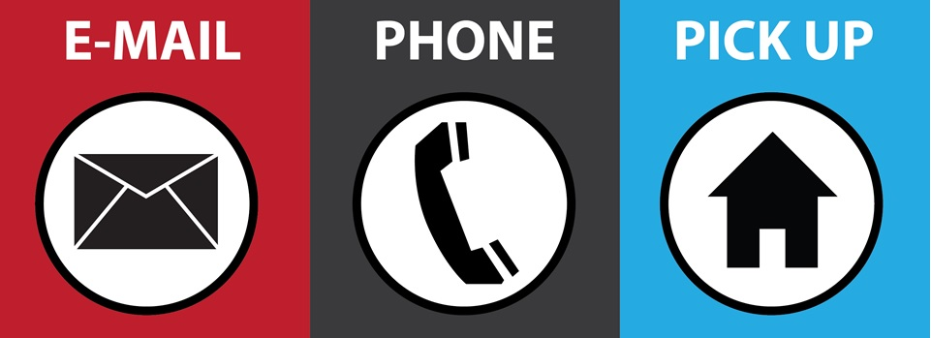
Harnell Harper Harnell Harper RR/CC Norwalk hharper@rrcc.lacounty.gov 562 462 2364 12400 Imperial Hwy
Norwalk, CA 90650
3rd floor room 3002

Slide 24
Questions about the LA Free the Vote Campaign?
Contact Jessica Sarriot
Email: Jsarriot@dhs.lacounty.gov
Thank you!

